Slide 1




NEXT GEN EMPLOYABILITY PROGRAM
Creating a future-ready workforce
Team Members
College Name
Student Name:
R.Sruthi
Student ID :814721104054
SRM TRP ENGINEERING COLLEGE

Slide 2

CAPSTONE PROJECT SHOWCASE
Project Title
Notes Sharing Web Application using Django Framework
Abstract | Problem Statement | Project Overview | Proposed Solution | Technology Used | Modelling & Results | Conclusion

Slide 3
Abstract : A Collaborative Notes Sharing Platform READ SEE is a web application developed using Django, offering users a seamless way to create, manage, and share notes collaboratively. Key features include: User Authentication: Secure registration and login system for user management. Notes Management: Users can create, edit, and organize notes with rich text formatting. Collaborative Sharing: Share notes with others and manage permissions for viewing and editing. Search and Filtering: Robust search functionality to quickly find specific notes.
Source :

Slide 4
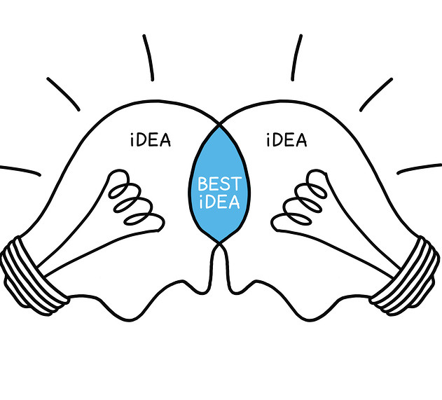
Problem Statement: The primary challenge is to develop a user-friendly web application that allows individuals to create, organize, and share notes effortlessly. “READ SEE”aims to enhance collaboration among users by providing robust sharing capabilities while prioritizing simplicity and security.
Source :

Slide 5
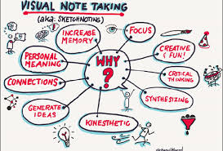
Project Overview: In today's digital age, effective collaboration and information sharing are crucial for productivity and learning. However, existing note-taking tools often lack seamless collaboration features and intuitive user experiences. To address this need, we propose building “READ SEE" - a web-based notes sharing platform powered by Django
Source :

Slide 6
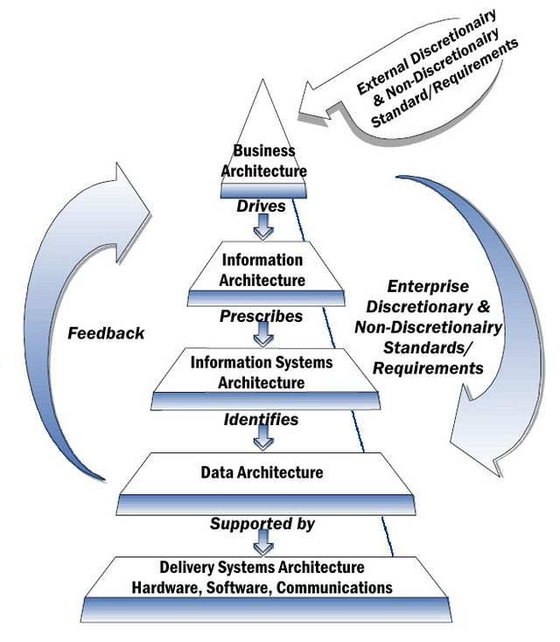
Proposed Solution :
. Search and Filtering
Collaborative Sharing
Security and Validation
Collaborative Sharing
Testing and Debugging
Source :

Slide 7


Technology Used
Front-end
Back-end
Source :

Slide 8
Modelling & Results : Modeling enhancements for the Notes Sharing Web Application using Django, several key additions can significantly augment functionality. For instance, incorporating models for real-time collaboration could involve defining a CollaborativeSession model to manage sessions where multiple users edit shared notes concurrently. As a result of these modeling enhancements, users would benefit from seamless real-time collaboration capabilities, allowing multiple users to edit notes simultaneously with changes reflected instantly. The addition of version control would provide a safety net, empowering users to track and revert to earlier versions of their notes, fostering a more robust and flexible note-taking experience within the application.
Source :

Slide 9
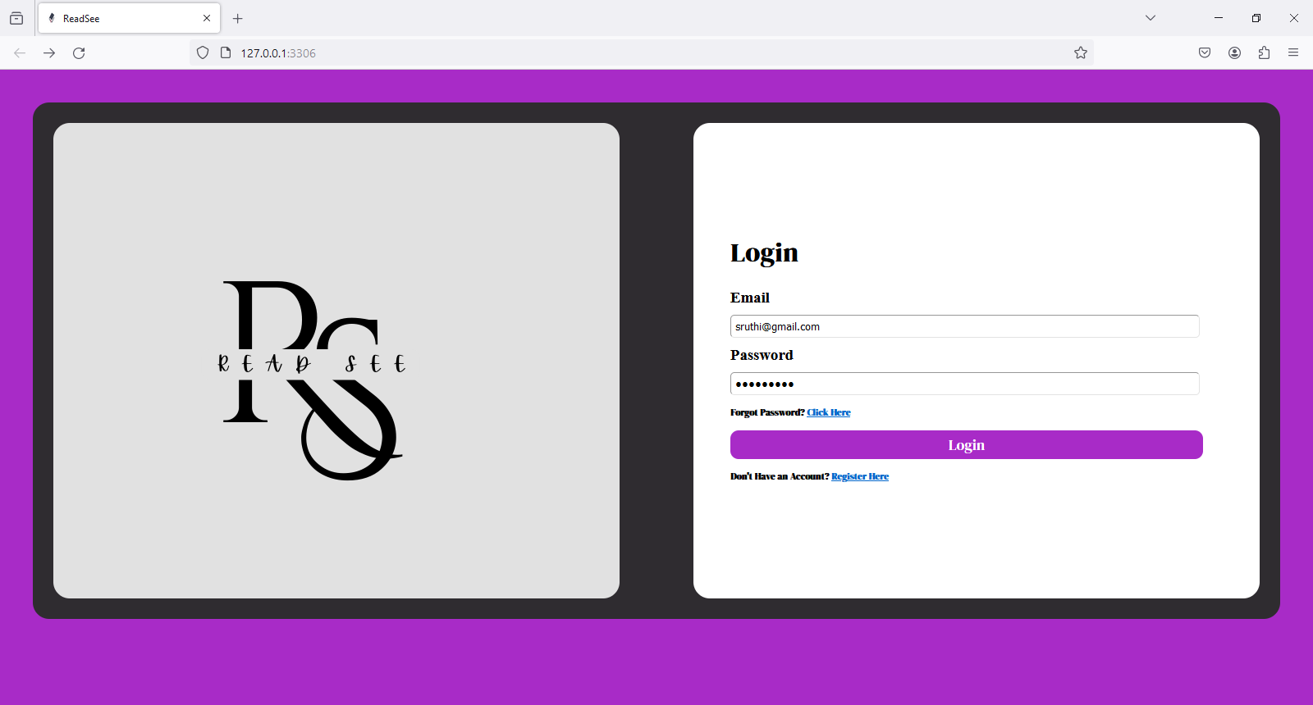
Login page

Slide 10
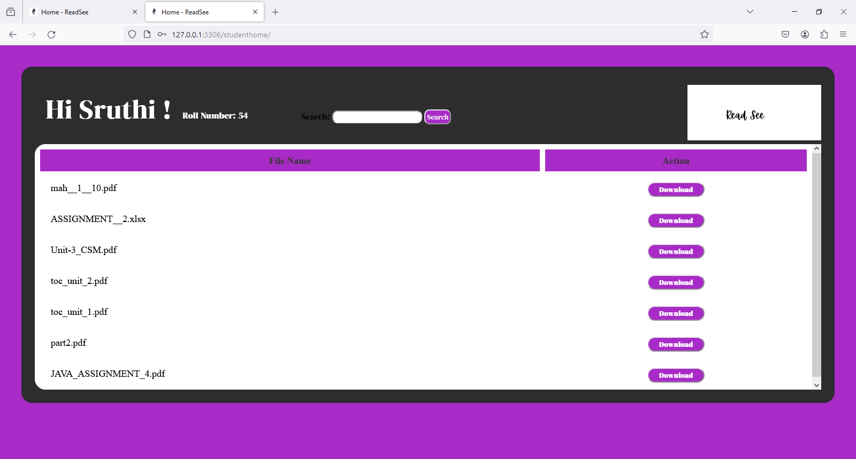
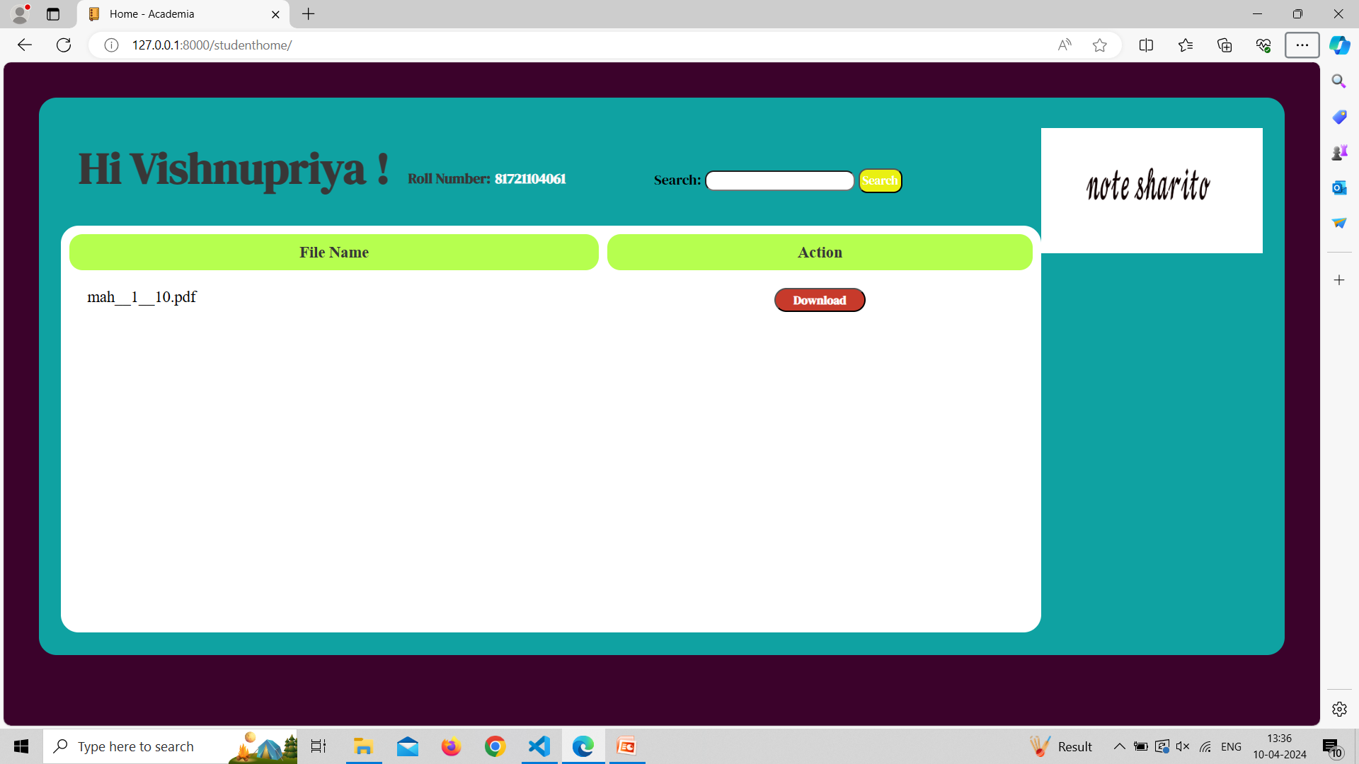
STUDENT HOME PAGE

Slide 11
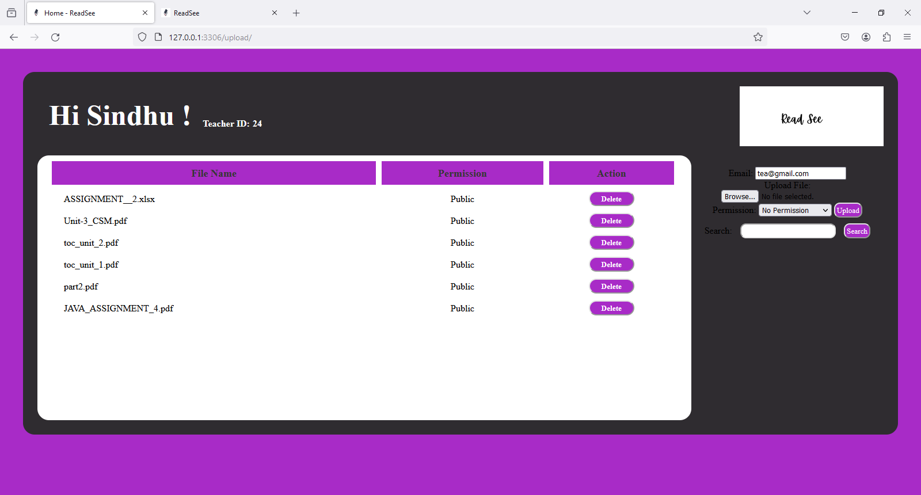
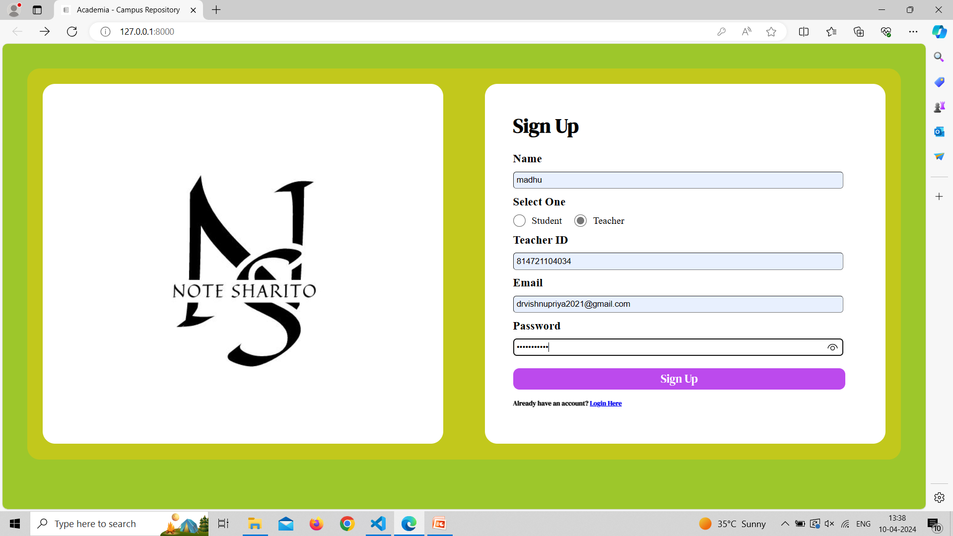
TEACHERS HOME PAGE

Slide 12
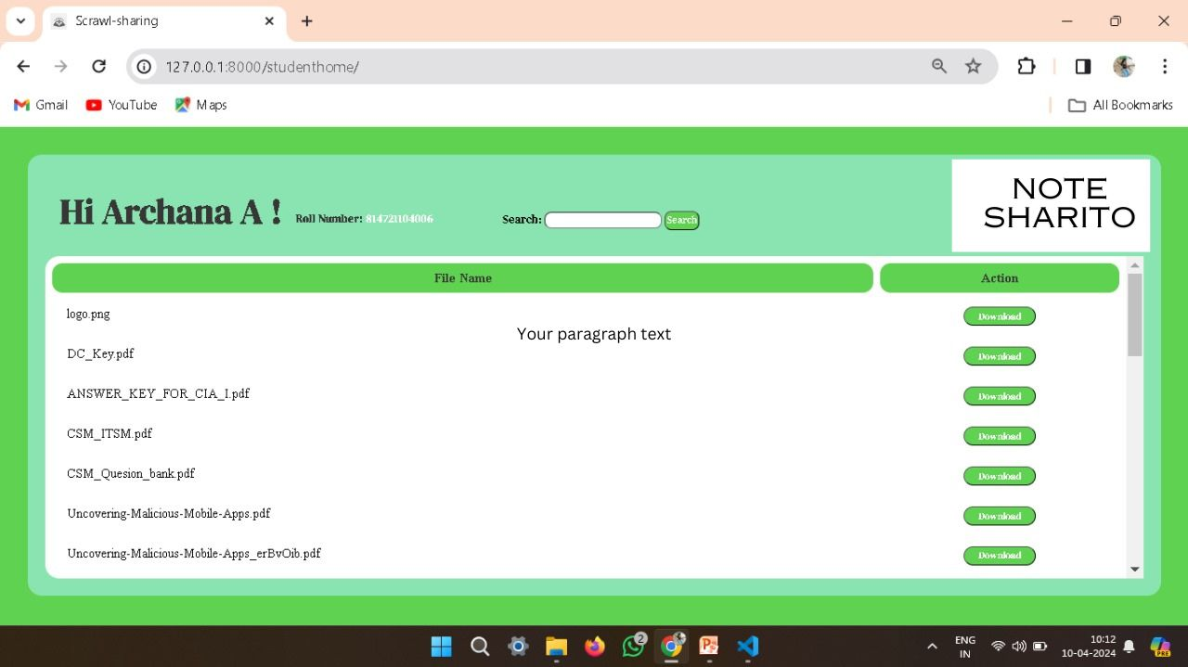
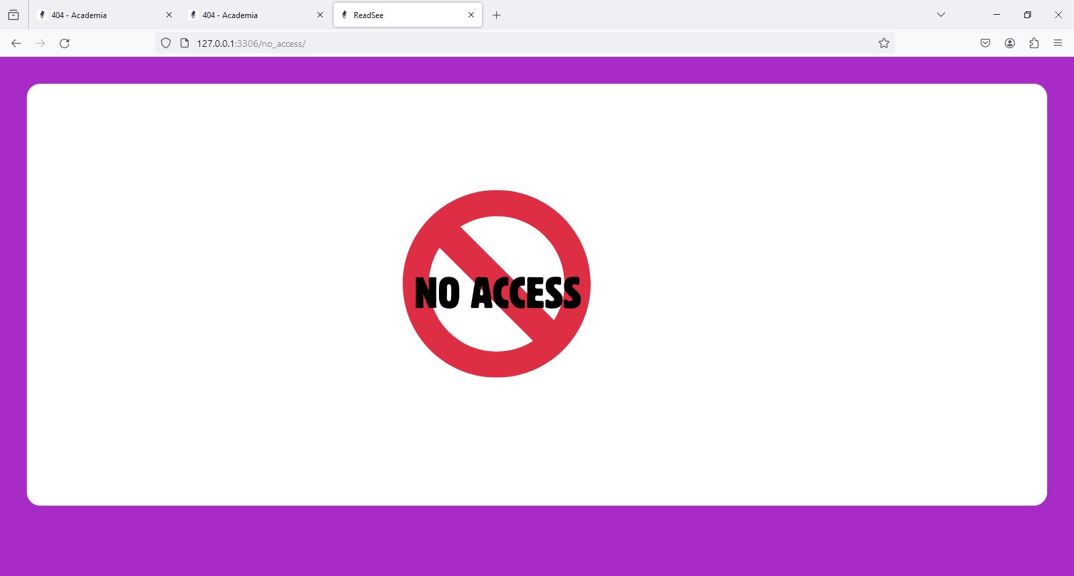
NO ACCESS

Slide 13
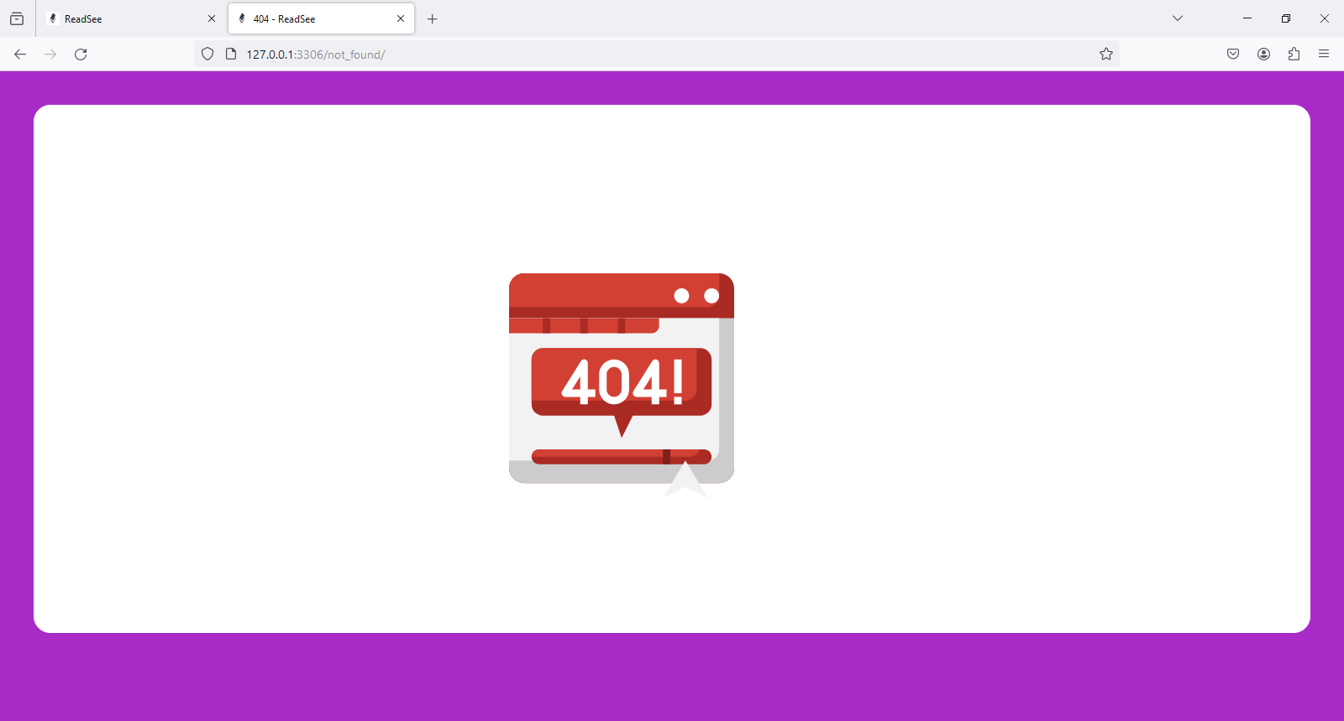
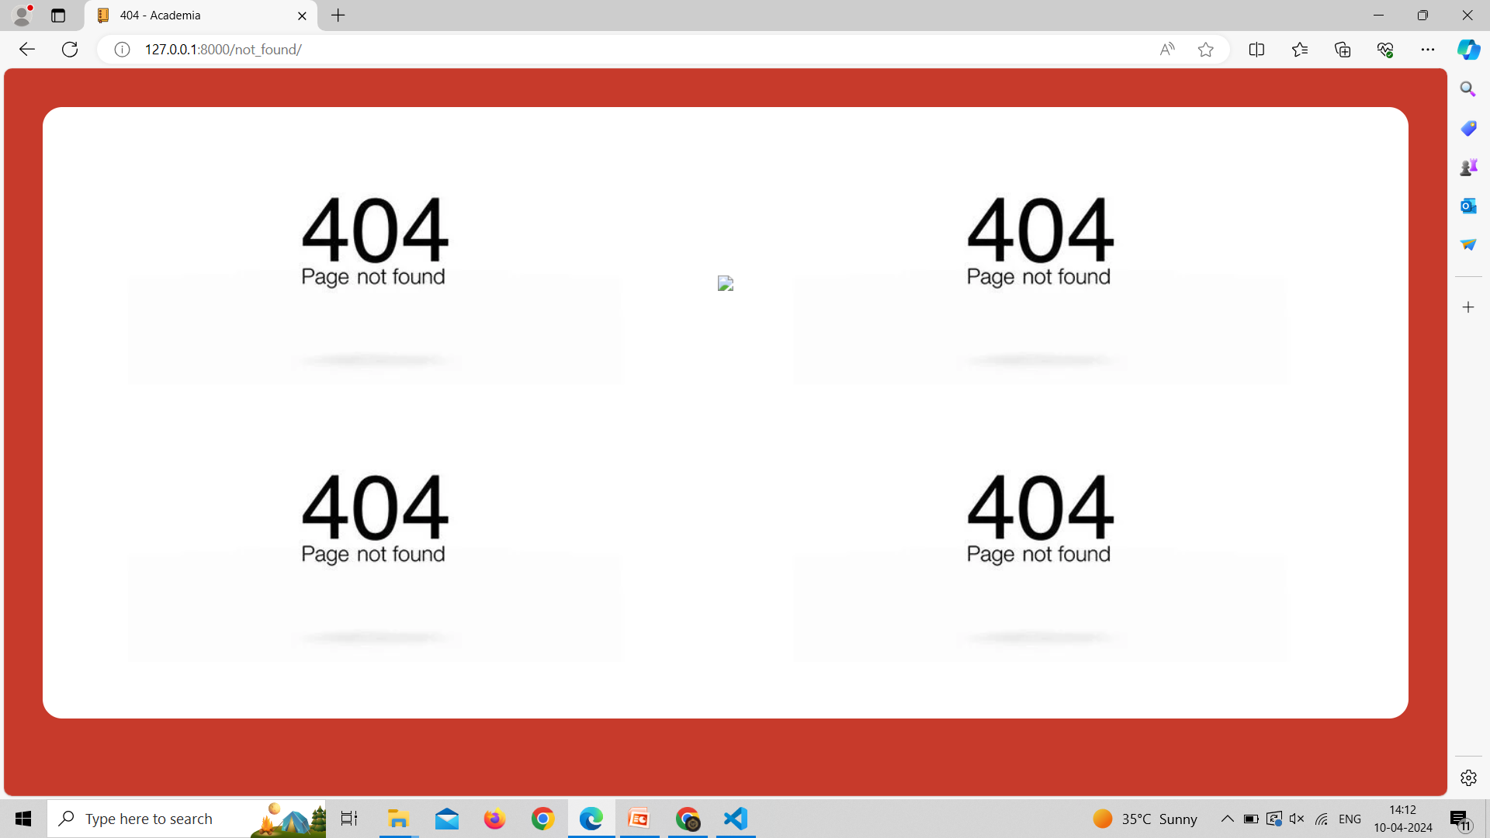
NOT FOUND PAGE

Slide 14

Future Enhancements:
Version Control for Notes
Introduce version control functionality to track and manage revisions of notes, allowing users to view and revert to previous versions
Advanced Search and Filtering
Enhance the search functionality with advanced filtering options, such as filtering notes by tags, categories, or custom attributes.
Mobile Application
Develop a companion mobile application (iOS/Android) to provide users with seamless access to their notes on mobile devices with offline support.
Notifications and Activity Feeds
Implement notifications for note sharing, comments, and updates to keep users informed about activities related to their shared notes.

Slide 15
Conclusion: By modeling the database schema with Django models and implementing views, templates, and forms for notes management and sharing functionalities, you can create a fully functional Notes Sharing Web Application using Django framework. Customize and expand upon these components based on your specific requirements and add additional features as needed to enhance the application's usability and user experience. Ensure to test the application thoroughly and handle security considerations such as user authentication and data validation for a robust and secure web application.
Source :

Slide 16
Thank You!
Notes:
Thank You !!

